Slide 1

AI-Powered Battery System Performance Prediction
CSE 496
Second Presentation
Dicle ÇOBAN
Advisor: Asst. Prof. Salih SARP
Asst. Prof. Osman Safa ÇİFÇİ
April 2026
www.gtu.edu.tr

Slide 2
Contents
Project Definition
Dataset Update
New External Dataset
Labeling Update
Feature Engineering
Main Results and Next Steps
References
www.gtu.edu.tr
CSE496 – First Presentation
11.03.2026
2

Slide 3
Project Definition
Background: Battery degradation causes capacity loss and eventual failure. Predicting cycle life accurately and across different battery types remains an open challenge.
Fall Semester Result: Built a cycle-life prediction pipeline on the MATR dataset (93 LFP cells, 8 engineered features, CatBoost model).
Best CV result: MAE ≈ 96 cycles, SMAPE ≈ 13%.
Two Gaps:
Point estimates → no uncertainty bounds.
Single dataset → generalizability to other battery types unknown.
Battery Data
AI Models
Confidence / Reliability
www.gtu.edu.tr
CSE496 – First Presentation
11.03.2026
3

Slide 4
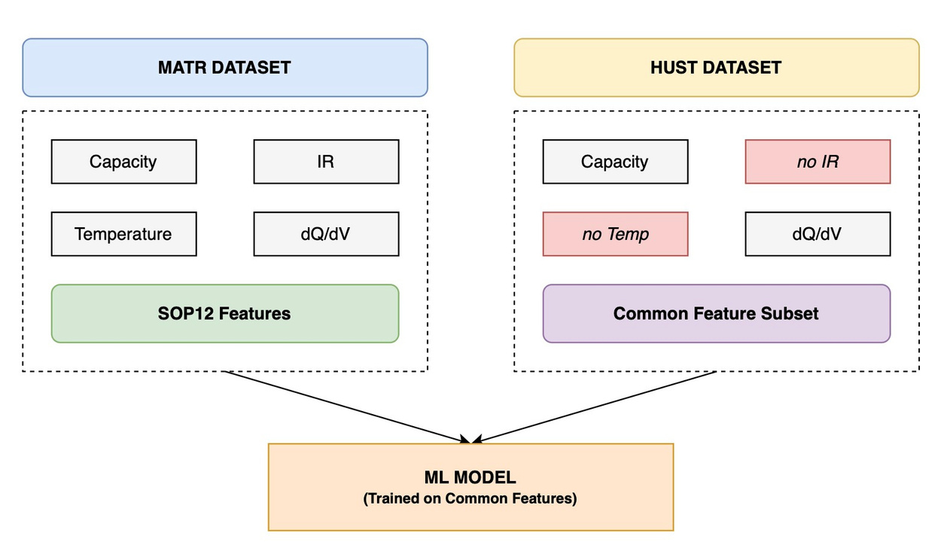
Dataset Update
Correction in Dataset Setup
Batch1 and Batch2 are not separate datasets
Batch1 + Batch2 + Batch3 together form MATR
I updated the experiments based on this correction
www.gtu.edu.tr
CSE496 – First Presentation
11.03.2026
4

Slide 5
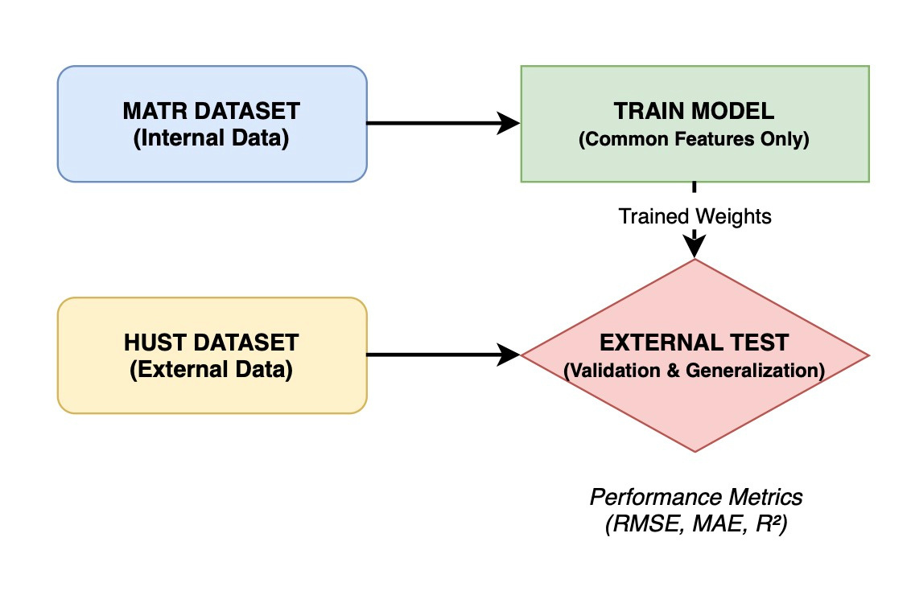
New External Dataset
HUST Dataset
I added HUST as an external test dataset
New cross-dataset setting:
Train on MATR
Test on HUST
This gives a more realistic evaluation
www.gtu.edu.tr
CSE496 – First Presentation
11.03.2026
6

Slide 6
Labeling Update
EOL Definition and Censoring
I built: Q0 calculation, EOL labeling, censoring flags
First, I used 80% of Q0, Then I changed EOL to 85% of Q0
Why 85% EOL?
At 80%, many MATR cells were censored
At 85%, censoring became much lower
This made the target definition more usable
www.gtu.edu.tr
CSE496 – First Presentation
11.03.2026
7

Slide 7
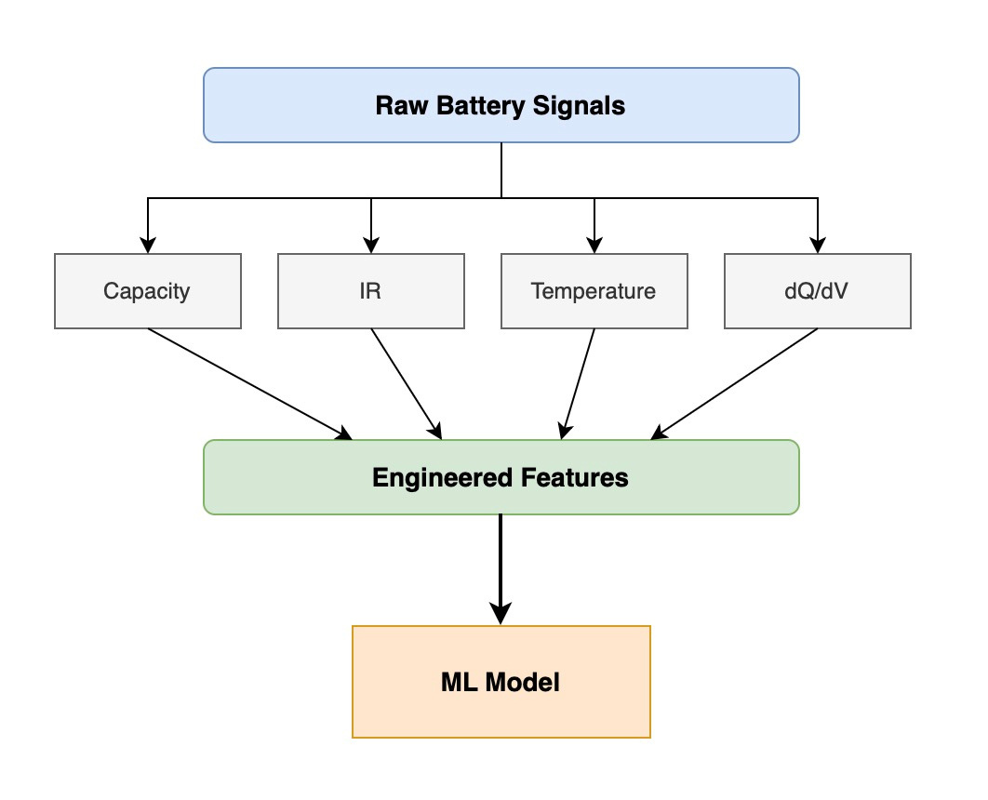
Feature Engineering
I created a SOP-style feature pipeline
For MATR, I built a 12-feature table
For HUST, full SOP12 was not possible
HUST does not contain IR and temperature
www.gtu.edu.tr
CSE496 – First Presentation
11.03.2026
7

Slide 8
Main Results and Next Steps
Conclusion
I corrected the MATR dataset setup
I added HUST for external testing
I updated EOL from 80% to 85%
I completed within-dataset and cross-dataset experiments
Next Step
Finalize report tables and presentation figures
Current Findings
Within-dataset results are better
MATR to HUST performance is much lower
Cross-dataset prediction is difficult
Possible reasons:
feature mismatch
dataset differences
www.gtu.edu.tr
CSE496 – First Presentation
11.03.2026
7

Slide 9
References
Hu, X., Che, Y., Lin, X., & Onori, S. (2020). Battery health prediction using fusion-based feature selection and machine learning. IEEE Transactions on Transportation Electrification.
NASA Open Data Portal. (2022). Li-ion battery aging datasets. Retrieved from data.nasa.gov
Zhu, J., et al. (2022). Data-driven capacity estimation of commercial lithium-ion batteries from voltage relaxation. Nature Communications.
Severson, K. A., Attia, P. M., Jin, N., Perkins, N., Jiang, B., Yang, Z., Chen, M. H., Aykol, M., Herring, P. K., Fraggedakis, D., Bazant, M. Z., Harris, S. J., Chueh, W. C., & Braatz, R. D. (2019). Data-driven prediction of battery cycle life before capacity degradation. Nature Energy, 4, 383–391.
www.gtu.edu.tr
CSE496 – First Presentation
11.03.2026
8

Slide 10
Thank You
Written by Dicle Çoban
Supervisors: Asst. Prof. Salih SARP
Asst. Prof. Osman Safa ÇİFÇİ
Student ID: 220104004088
www.gtu.edu.tr
CSE496 – First Presentation
11.03.2026
13

